Slide 1


Amber Molecular Dynamics AI Powered Chatbot Assistant
Braedon Edison Gavin Chan Luis Vicente Cruz Alejandro Urbano Christian Perez Leonardo Pahtle Quechol Luciano Aldana Isaiah Villalobos Ira Vizcarra
Astrid Zepeda Benjamin Saucedo
Graduate Student Assistant: Nikhil Dhiman Faculty Supervisor: Dr. Negin Forouzesh

Slide 2
Presentation
Outline
Introducing Amber
Project Design & Requirements
Database
Data Scraping
Retrieval-Augmented Generation (RAG)
Results & Discussion
Interactive Tutorial Notebooks
Conclusion + Q&A

Slide 3
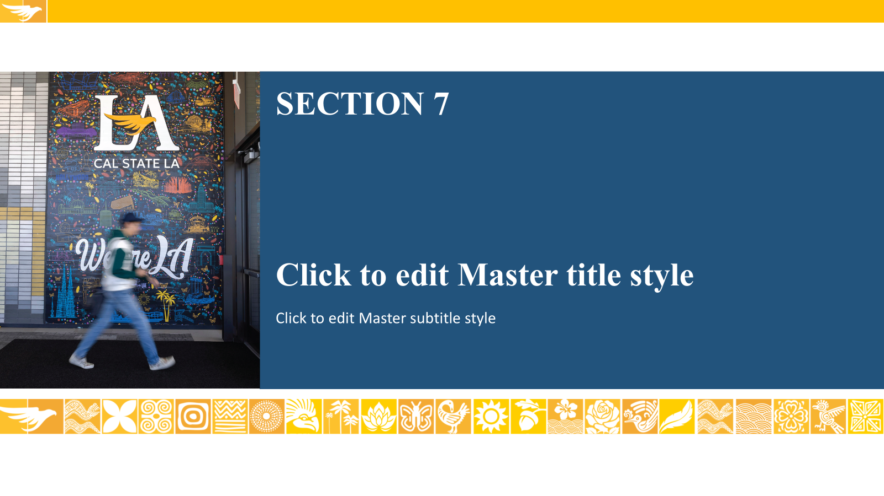

Background of Amber
Amber MD
Astrid

Slide 4


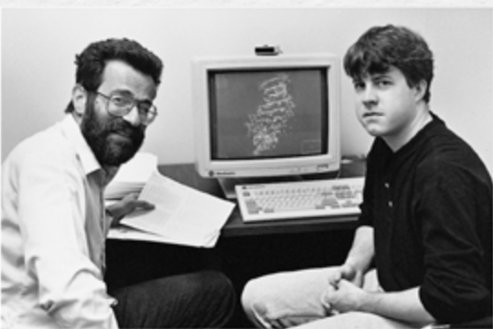
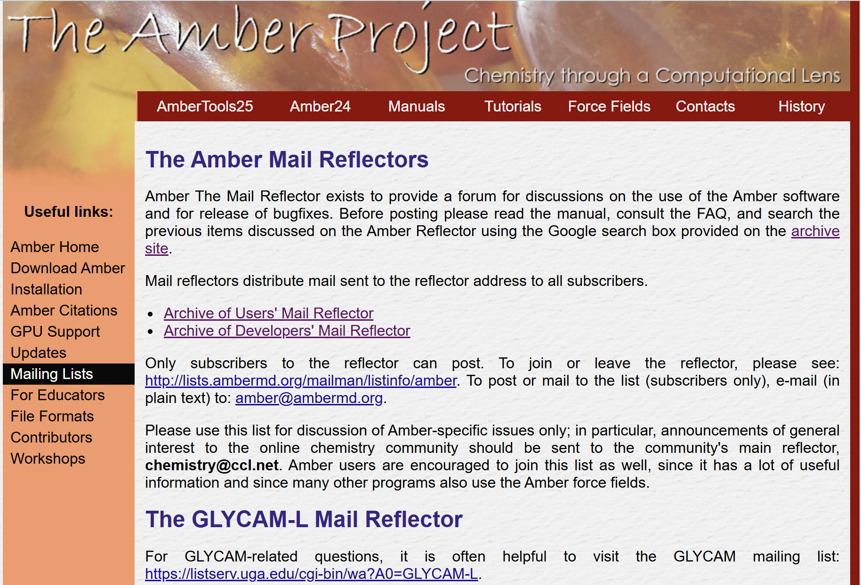
What is Amber?
A molecular dynamics software suite for simulating proteins, nucleic acids, and other biomolecules.
Built on trusted and widely used force fields for accurate atomic-level modeling.
Provides a full ecosystem for system preparation, simulation, and analysis.
Used globally in drug discovery, biophysics, and computational chemistry.
Astrid

Slide 5
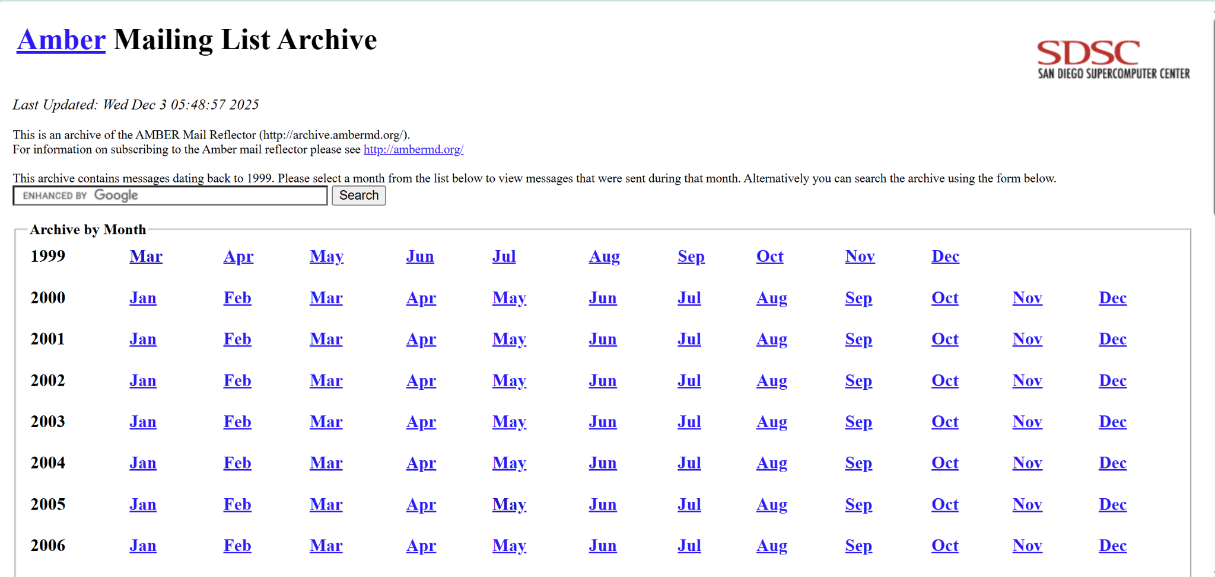
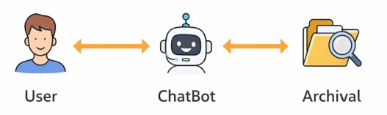
The Problem & Our Solution
Amber advises users to search the mailing list, manual, and FAQ before discussing questions. However, these resources are large and hard to filter manually.
Our proposed solution: create a chatbot experience for users to efficiently navigate Amber programs and inquiries.
Provide clear, step-by-step answers with links to original sources.
Agent collects missing details and verifies commands before responding.
Low-confidence cases are escalated to human support for reliability.
Astrid

Slide 6
Background of Amber
SRD Main Overview
Software Design & Requirements
Isaiah
Isaiah

Slide 7
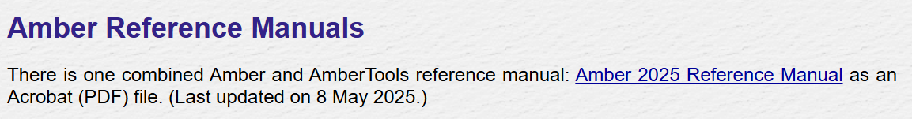





Functional Requirements
Ingest raw Amber mailing-list archives, tutorials, and related documentation into pipeline
Extract key metadata for each message
Generate embeddings using MiniLM-L6-v2 and store them in ChromaDB’s DuckDB/Parquet backend.
Maintain a consistent data model for reliable retrieval and RAG usage.
Automate daily updates so new mailing-list posts or tutorials are inputted
Provide logging and monitoring for scraping, ingestion, and indexing pipelines to ensure reliability.
Isaiah

Slide 8
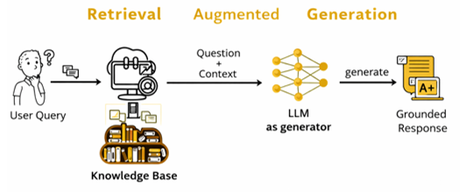
Use Case Diagram
Figure: Chatbot Use Case Diagram
Gavin
Notes:
Gavin

Slide 9
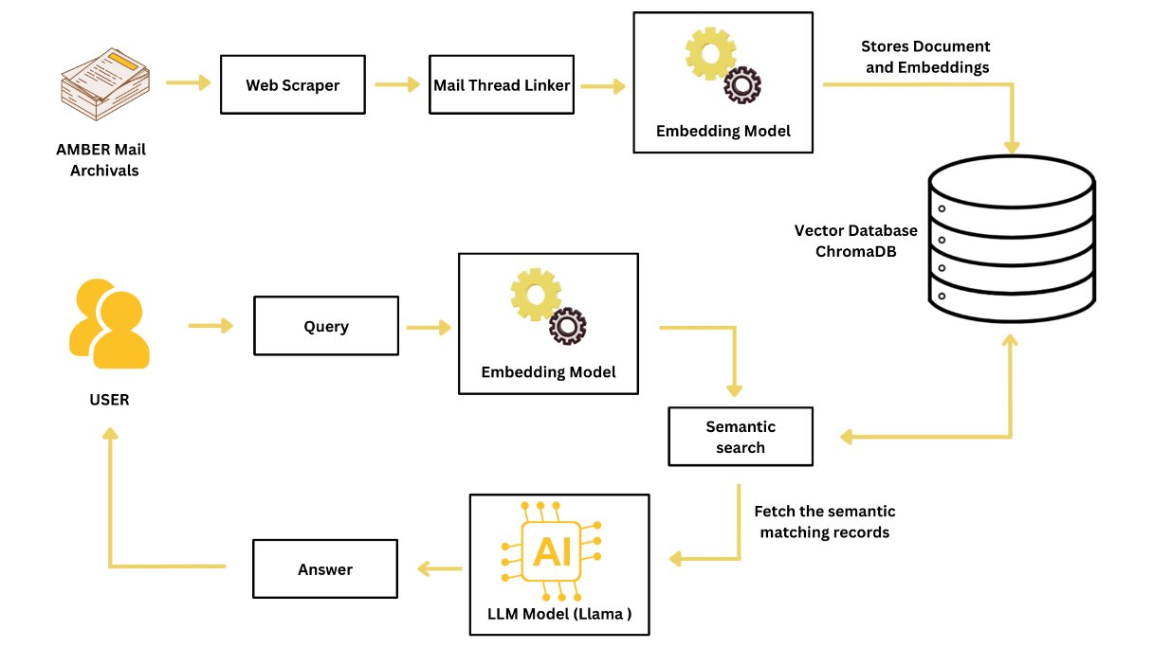
System Architecture
Figure: Data to Application Diagram
Gavin
Notes:
Gavin

Slide 10
Database Team
Background of Amber
Database
Luis

Slide 11
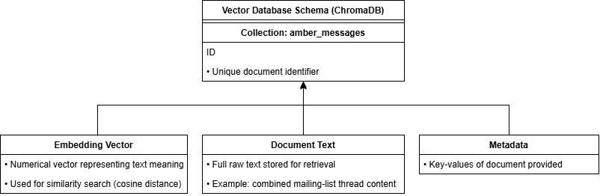
ChromaDB Overview
ChromaDB Architecture
Uses a fast “similarity search” system using vector embeddings to find related messages.
Stores everything locally on your computer in a portable database folder.
Saves each thread’s text, its embedding, and basic info together.
Luis

Slide 12
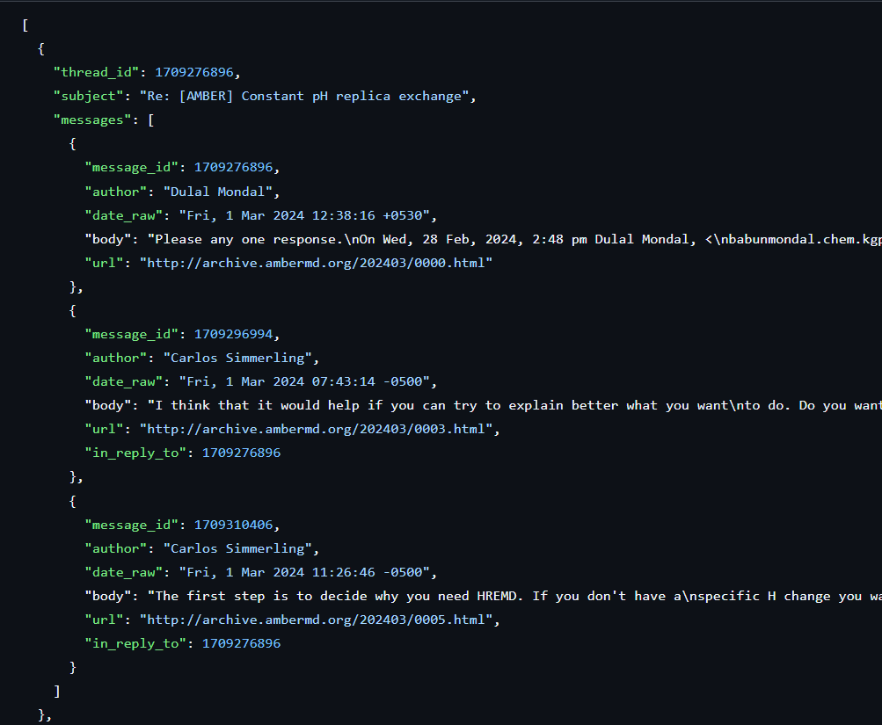
Database Overview
Our Implementation
Created one local ChromaDB folder for the project.
All Amber threads go into one collection called ‘amber_messages’.
Each thread is stored as one document with text, metadata, and embedding.
The system auto-indexes everything so searches are fast and accurate.
Luis

Slide 13
Data Scraping Team
Background of Amber
Data Scraping
Luciano

Slide 14
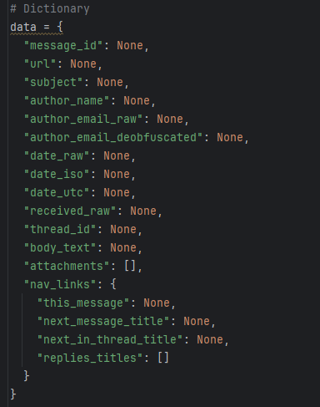
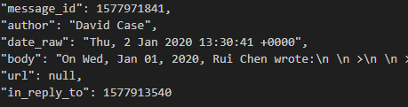
Scraper Scripts → JSON Parsing & Merging
Scripts download individual Amber mailing-list pages and save the raw HTML locally.
Each page is parsed into a clean, consistent, and semi-structured JSON record for easier processing.
Combines all individual message JSON files into a single JSON file per thread.
Unique numeric IDs using UUID so threads stay consistent, sortable, and easy to reference.
Reduces duplication and ensures metadata stays consistent across the entire thread.
Luciano

Slide 15
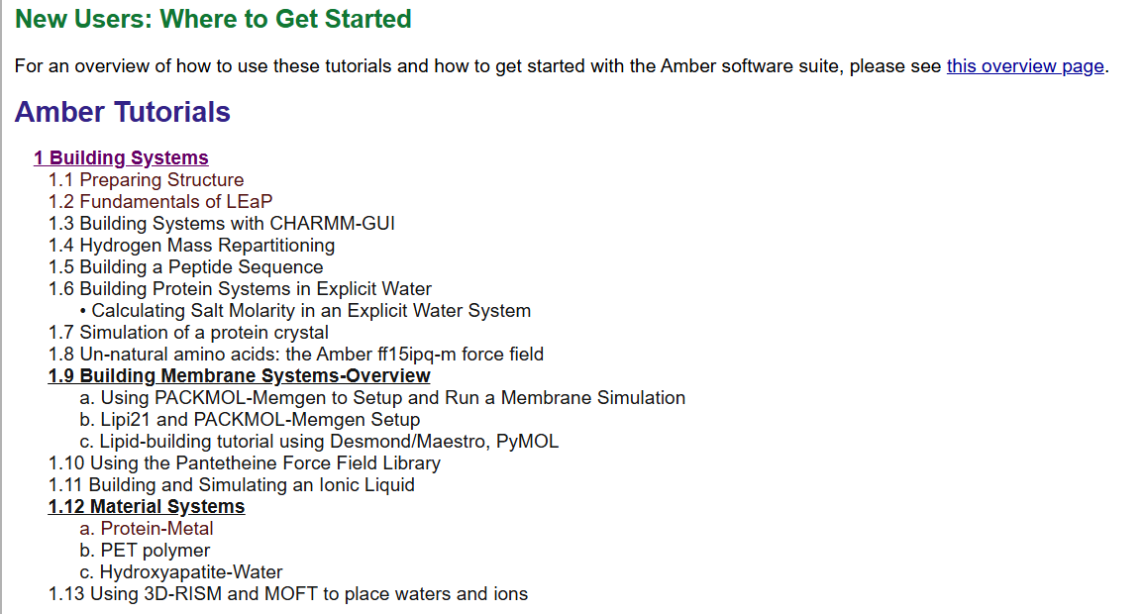
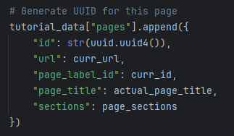
Tutorial Scraper Scripts
Scripts download relevant information in the online Amber Tutorials webpage using BeautifulSoup.
Filters out each non-valid page before assigning webpage to a queue.
Filters out and strips irrelevant navigational elements and HTML tags before extracting text
Tracks Visited URLs to avoid redundant and duplicate data collection
Similarly to the Mail Archives, UUID is used for unique numeric IDs. to stay consistent with prior metadata use
Luciano

Slide 16
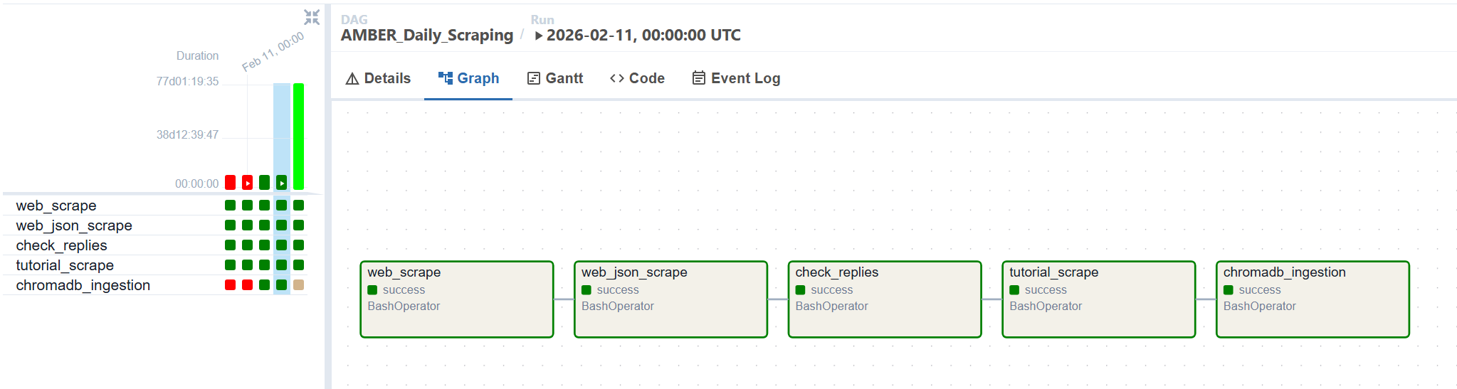
Workflow using Airflow
Airflow Background
Airflow automates and schedules multi-step data pipelines.
Runs tasks on a fixed schedule (hourly, daily, etc.) and handles failures and retries automatically.
Includes a web dashboard to monitor runs, logs, and issues.
Our Usage
Runs our “Schedule and Automata” pipeline that downloads, cleans, and stores new data.
Ensures the scraper runs once every 24 hours.
Lets us track task status, failures, and logs in real time.
Can easily expand later to manage more pipeline steps.
Alejandro

Slide 17
RAG Team
Background of Amber
Retrieval-Augmented Generation (RAG)
Ira

Slide 18
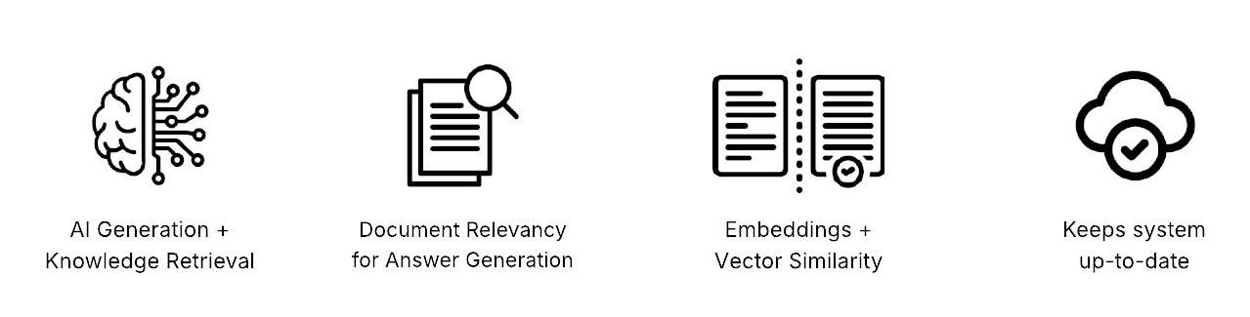

Benefits of RAG + Models Used
Embedding: all-MiniLM-L6-v2
Easy integration
Fast performance despite being a smaller model
Low memory, suitable for local deployment
LLMs: Ollama + Llama3
Previously: google/flan-t5-large
Reasons for change:
Ollama allows easy setup for running LLM models locally.
Also allows fine-tuning by being able to change weights
Ira

Slide 19
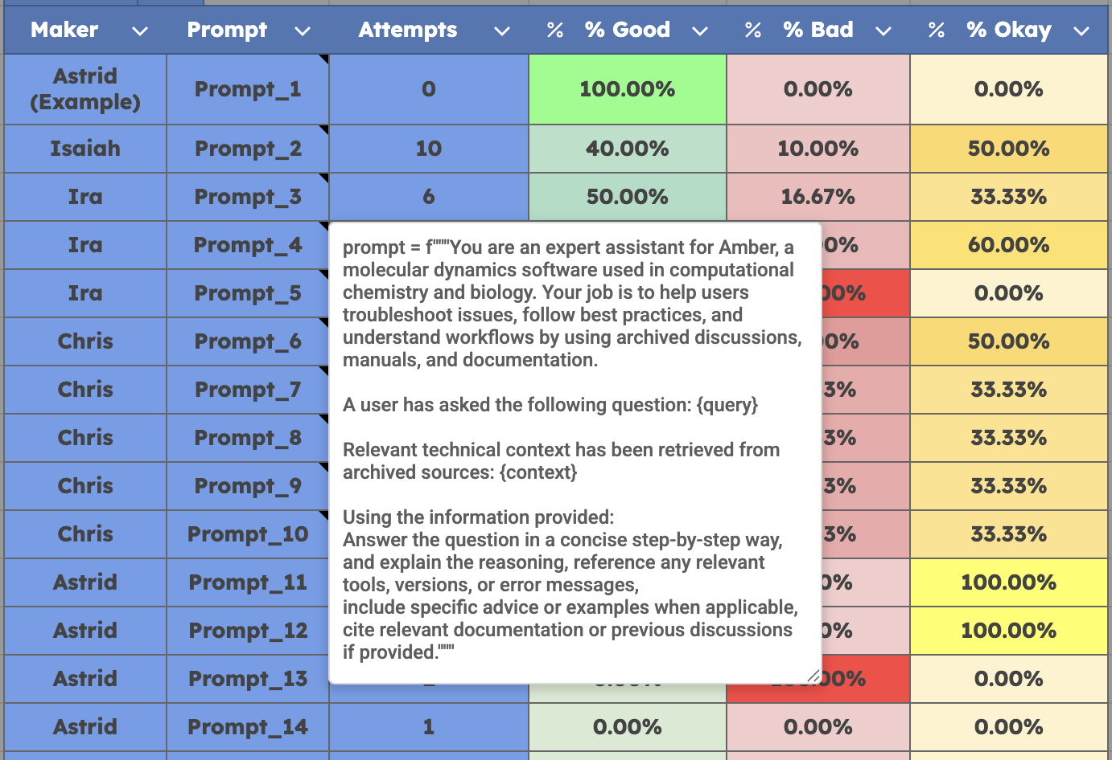
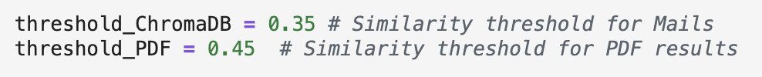
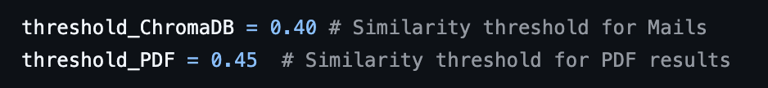
Fine-tuning
Fine-tuned the LLM to produce more accurate and context-aware responses
Applied similarity threshold weights for each type of source retrieved from the database
Improves the relevance and reliability of the results
Reduces hallucination
Ran tests with various prompts
Different rules/instructions
Specified output formatting
Changed threshold weight values for retrieving documents
Higher threshold weight = strict
Lower threshold weight = less strict
before and after:
Ben

Slide 20
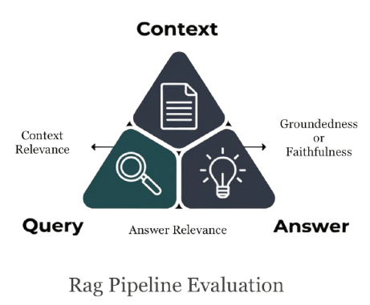
Evaluation Metrics
Terminology
Cosine Similarity: Measures similarity of text inputs by using cosine of both vector embeddings
Keyword Overlap: Matches documents to queries based on exact word matches and frequency to generate responses
Cross-Encoder: Text inputs (queries and answers) are processed simultaneously to produce a single relevance or similarity score
Ben

Slide 21
RAG Team
Background of Amber
Results
Ira

Slide 22
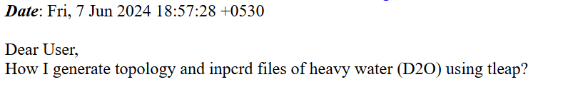
Sample Response
ChatBot Answer: To generate topology and inpcrd files of heavy water (D2O) using tleap, you can follow these steps:
Create a new topology file for D2O:
```
leaprc.water.tip3p
source leaprc.water.tip3p
loadAmberParams d2o.frcmod
mol = loadPdb d2o.pdb
saveAmberParm mol d2o.prmtop d2o.inpcrd
quit
```
Please note that `d2o.frcmod` is a force field file for D2O, and you may need to create it first.
AMBER Developer Answer: You could use parmed to modify the masses in the prmtop. However, think carefully about whether you really need to do this, and what difference from normal water you are trying to model.
Ira

Slide 23
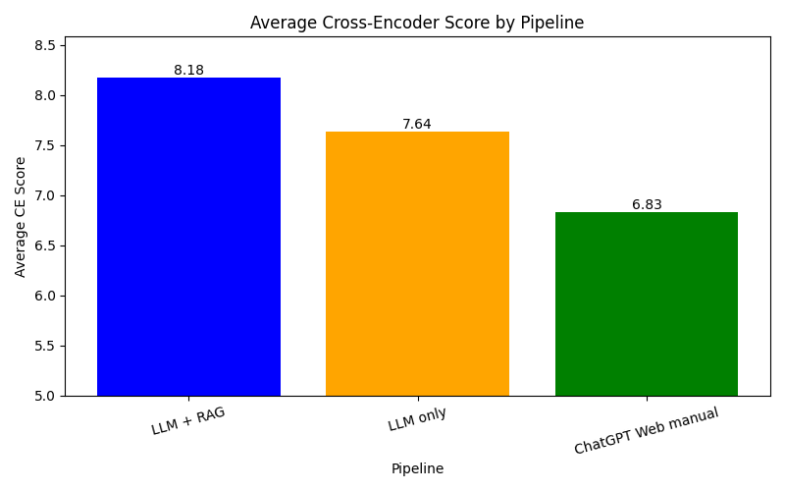
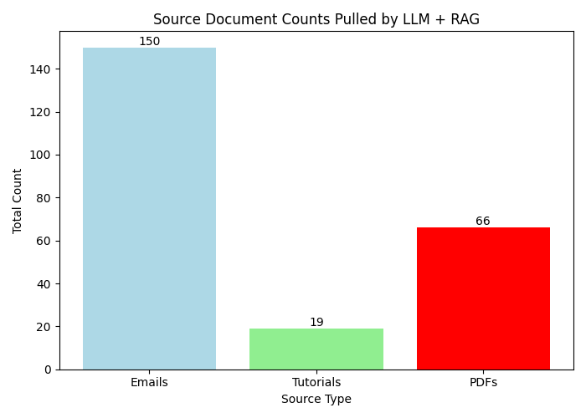
Results
Cross Encoder Test shows our LLM + RAG has more similarity with the correct answers than LLM and ChatGPT by itself.
Source Documents pulled test shows how many sources are being pulled when asking a query. Depending on how the question is formatted, it will choose the top 5 CE Score.
Christian Perez
Notes:
We asked 47 questions and from those inquiries we noticed that the Cross Encoder Similarity test was the highest for our LLM + RAG model. From the first bar graph we can see that the blue bar is the highest out of all of them. The Llama model came in second while ChatGPT came in last. From the inquires we asked we noticed most of the sources were being pulled from the Emails. This is because the questions were formatted in a “why or how” format instead of a “Step by Step”. When the query is asked Step by Step we would receive more tutorial sources since they provide more relevant information on how to solve the issue. Using our cross encoder test we picked out the top best 5 sources that had the highest CE scores.

Slide 24
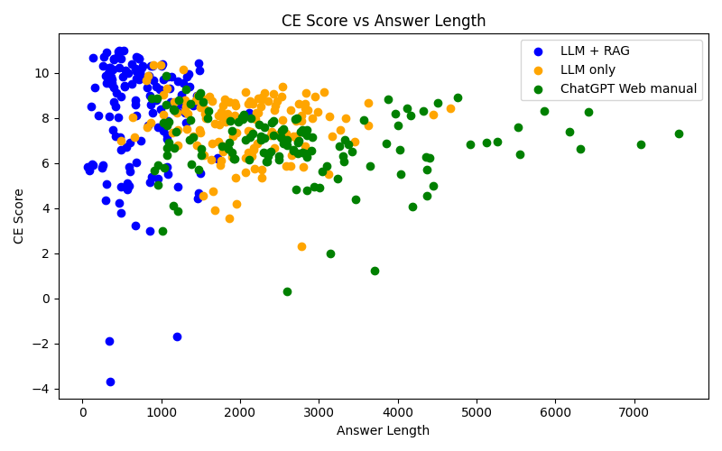
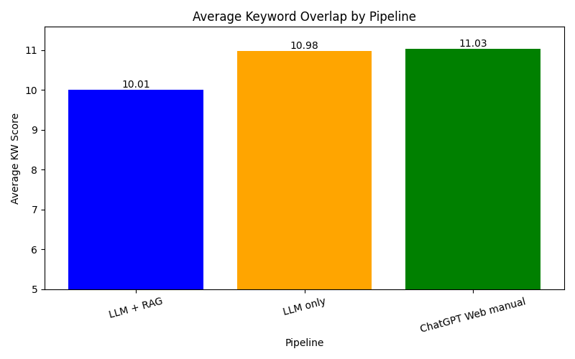
Results
Scatterplot shows LLM + RAG has the highest CE similarity score but less answer length.
Average Keyword Overlap shows which pipeline had the most keywords searched. LLM + RAG is the lowest but still results in the highest CE similarity score.
Christian Perez
Notes:
From the first scatter plot graph we notice how our LLM + RAG model has the highest CE similarity scores but results in less amount of word length. While the Llama model shows it is the 2nd best with more of an answer length than LLM + RAG. ChatGPT on the other hand has the highest word length with the lowest CE similarity score. The bar graph showing average keyword overlap shows us that ChatGPT had the highest keyword overlap than the other two pipelines. Even though the keyword overlap is the lowest for our LLM + RAG we resulted in more accurate information for our model. The keyword overlap test is a fallback in case the cross encoder doesn’t have high scores. Which is another reason why it’s lower for our LLM + RAG model.

Slide 25
What’s Next
Background of Amber
Interactive Notebook Tutorials
Braedon

Slide 26
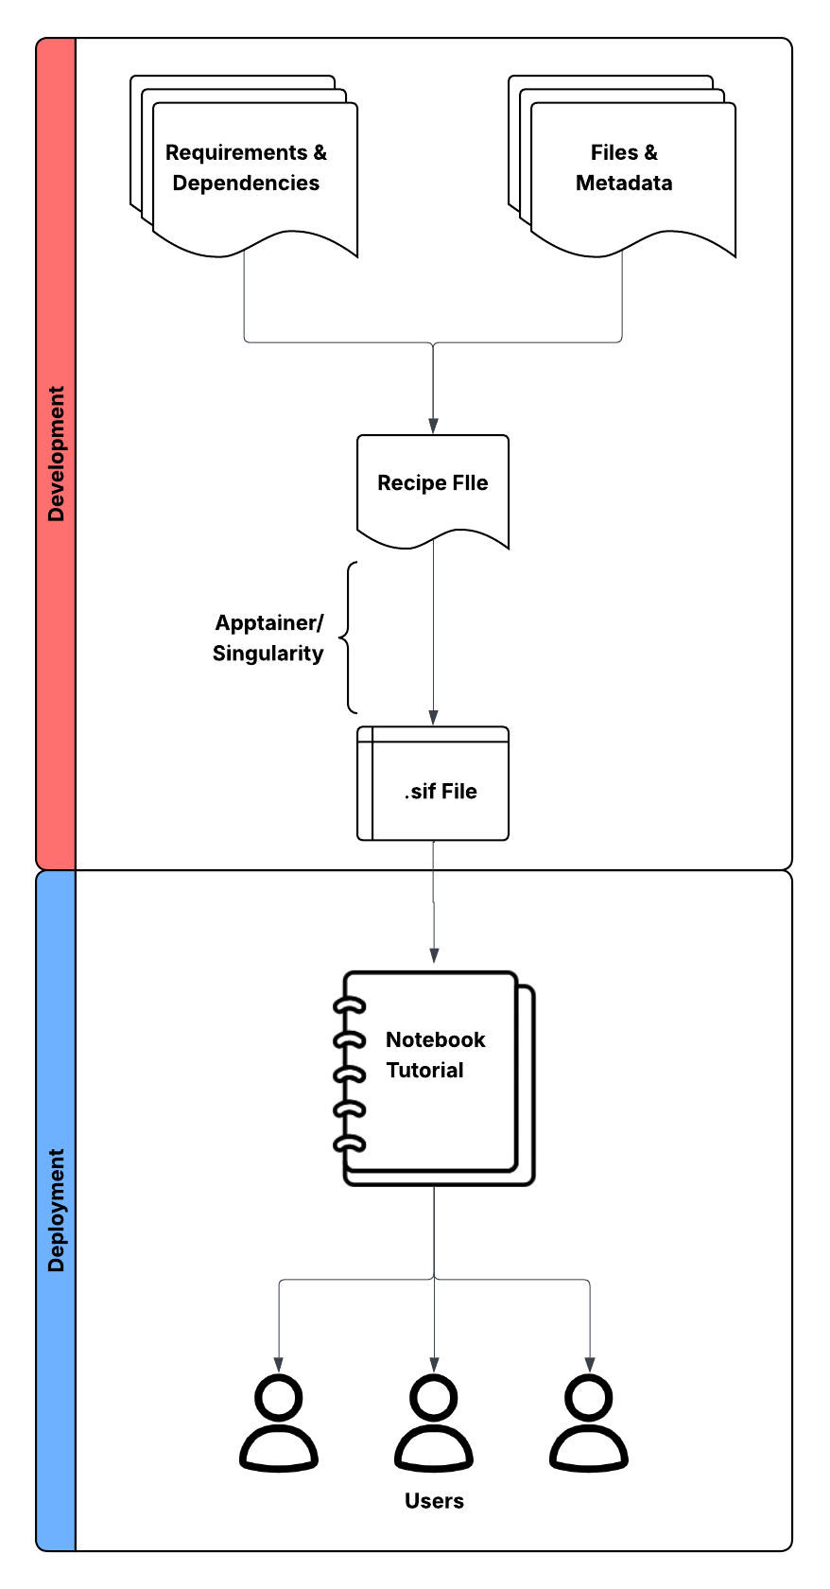


Guide to Notebook
Jupyter Notebook chosen for: Accessibility, Simplification, and Reproducibility Google Colab integration stopped for incompatibility with Apptainer
Definition file with base image; add files, requirements, and dependencies for desired environment.
Turn definition file into container image (.sif), used in notebooks to run same installed packages and system libraries every time.
Notebooks generated with code lines listed in tutorials to streamline progress with Amber
Work built on: Amberity (Gerald Monard)
Built notebooks with image based on AmberTools, a lite version of Amber. Current notebooks encompass Amber tutorials 3.1 - 3.3
Braedon

Slide 27
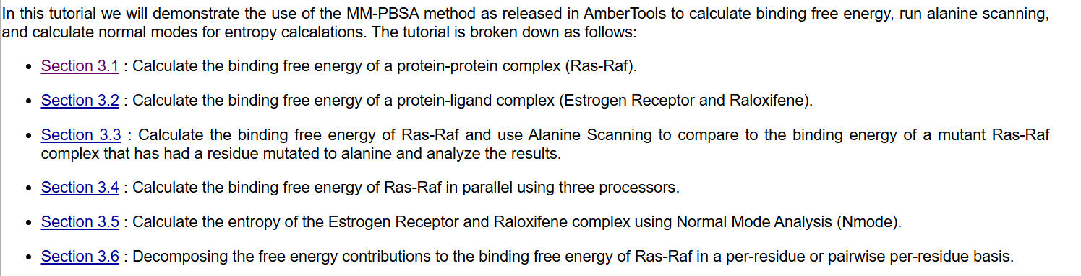
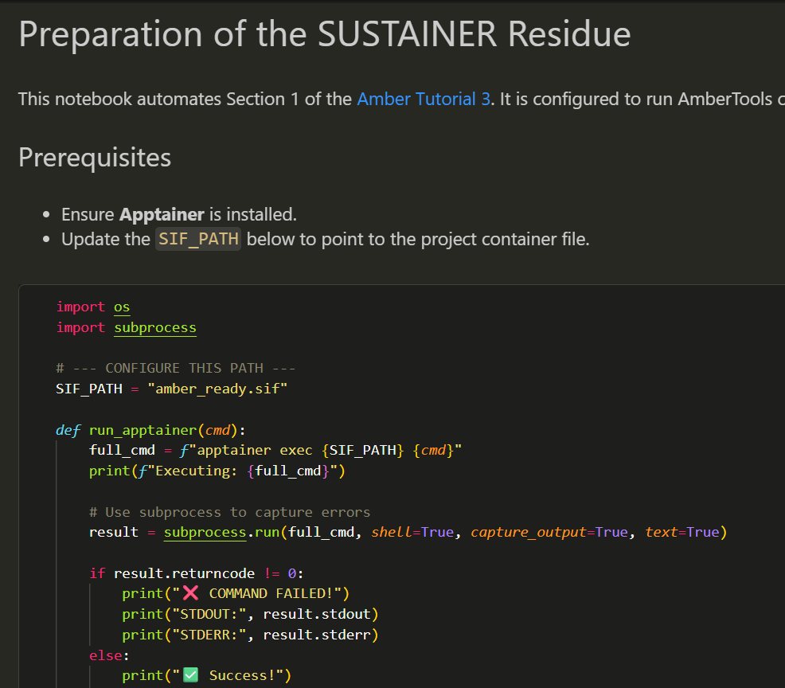
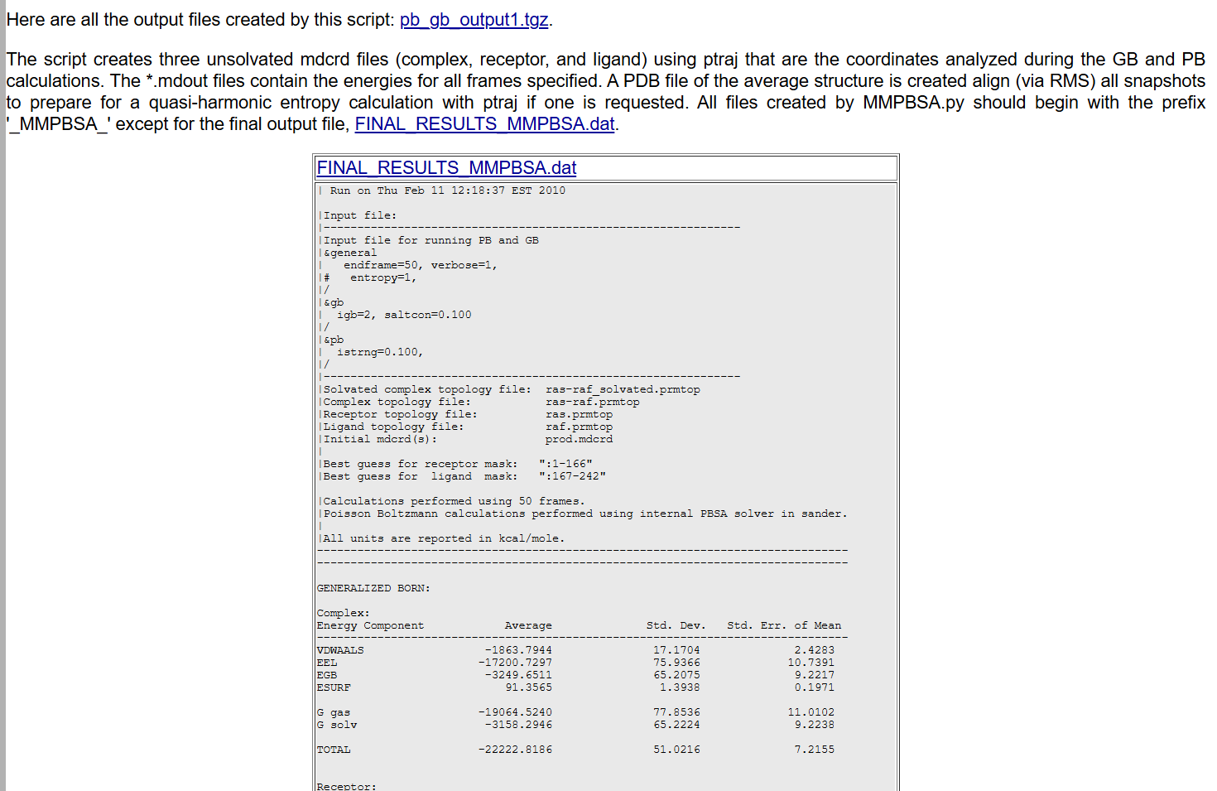
Comparison
Current tutorials
Improved tutorial notebooks
Leo

Slide 28
What’s Next
Background of Amber
Tasks Achieved
Isaiah

Slide 29
Tasks Completed
Database
Completed construction of ChromaDB vector database, with embeddigns and storage of scraped web pages, tutorials, manuals, and mailing data
Datascraping
Developed Web Scraper for Particular Page, Mailing Archives (2020-25), & Amber Tutorials
Developed Storage Scripts
Parsed Single HTMLs into JSON files, later Thread-level JSON files
Automated Scraping & Storage Processes using Airflow
Stored AmberMD Reference Manual PDF Data to Use in RAG Pipeline
Chunked the Content of Amber Tutorials
Retrieval-Augmented Generation (RAG)
Developed a completed RAG Pipeline using Ollama + LLama3
Fine-tuned pipeline using different comparison metrics to get the most accurate answers
Compared our chatbot’s performance with other LLMs
Isaiah

Slide 30
What’s Next
Background of Amber
What’s next?
Luis

Slide 31
Next steps
AI Chatbot
AI agent can ask follow-up questions to refine the user’s request
Automatically creates tickets for the developer team when new or unresolved issues arise
Enhances support workflow and ensures no complex question is missed
Prototype up and running on personal server. Plans for beta release to Amber developers for testing and improvement, eventual release for all Amber users
Interactive Amber Tutorials
Prototype in development with limited tutorials completed, but can be applied for wider selection once discussed with Amber team
Luis

Slide 32
What’s Next
Background of Amber
Thank you!
Braedon

Slide 33
References
What’s Next
Background of Amber
AmberMD Official Website
https://ambermd.org
Amber Mailing List Archive
https://archive.ambermd.org
AmberMD Tutorials
https://ambermd.org/tutorials/
Sentence-Transformers (MiniLM-L6-v2)
https://www.sbert.net
ChromaDB Documentation
https://docs.trychroma.com
DuckDB
https://duckdb.org
Apache Airflow Documentation
https://airflow.apache.org/docs
BeautifulSoup4 Documentation
https://www.crummy.com/software/BeautifulSoup/bs4/doc
Retrieval-Augmented Generation Overview
https://research.ibm.com/blog/retrieval-augmented-generation
Thank you!

